Slide 1

Case Study
      SBE Finance

Slide 2



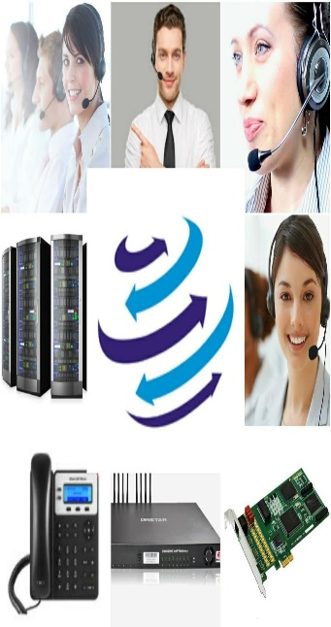



+91-856-00-00-600
www.dialerindia.com
avyuktaindia
CRM Based Dialer - IVR - Cloud Telephony
PRI Card - GSM Gateway - Servers - Headsets
(FXS/FXO/IP Phone// Press 1/ IP PBX)
Auto / Predictive / Hosted – WFH - PC Less – Android - Cloud Dialer
DoT Approved A / A+ Grade VoIP with/out Dialer Combo
Web / Software Development/e-Com / Custom Asterisk Solutions
+1-408-791-3820
+91-856-00-00-600
sales@dialerindia.com

Slide 3
SBE Finance Case Study
About SBE Finance
SBE Finance ( Shree Balaji Enterprises Finance ) is one of the Leading DSA's of Rajasthan. Its Head Office is located at Jaipur, Rajasthan . SBE Finance believe in Smart work Rather than Hard work and that is how they do all the Smart work for their customers and provide them best offers for Banking Personal Loan. Choosing SBE Finance can help customers saves up to 30% on EMI and save some amount while repaying the loan amount. SBE Finance provide direct Bank offers by doing in-depth study of available offers as per customer’s CIBIL Score and past repayment history.
SBE Finance is 4+ Years Old DSA, Affiliated with 7+ Banks like ICICI, HDFC, Axis, Yes Bank etc , and Connected with 10+ NBFCs like Bajaj Finserv, Mahindra & Mahindra Financial Services Limited, Muthoot Finance Ltd , Tata Capital Financial Services Limited etc.

Slide 4
SBE Finance Case Study
SBE Finance Requirements
SBE Finance needed a system with third party solution to accumulate all the information on a single platform. They wanted a solution which can give them flawless calling solution as well as can manage their Client’s Database, Calling schedule management, All Logs and recordings under single platform as before our solution they were managing such things like Client Meetings scheduling, Call-back Management, New Clients Management manually on multiple platforms which was tedious and too much time taking and even after a lot of hard work their records were still scattered on multiple channels . And due to this the optimum productivity from team is now coming as well as customer connectivity and retention was also very time taking process with lower output.

Slide 5
SBE Finance Case Study
Challenges at SBE Finance
In Early stages we need to fetch the relevant data from their database which were scattered on multiple channels, with different condition.
We Needed to design the Database as per their requirements and needs to be integrated it with our Avyukta Dialer Suite.
To manage such information we created a details Info Guide with around 50+ fields and multiple dropdown selections where all Information can be available to the tele caller on a single screen.
Another big challenge was to maintain the privacy and security of data as Security of data is a major issue with all the clients.
Another requirement was Follow me routing and After hours routing flexibility.

Slide 6
SBE Finance Case Study
Solutions we implemented at SBE Finance
We implemented our Avyukta Dialer Suite with data migration from their database to our Dialer Database to maintain all their data under single roof.
Complete case history availability for Incoming or outgoing calls to the tele caller screen instantly for existing customer along with their eligibility for the finance and for New case / lead tele caller can updated the details on single screen which we had designed for them.
Few clicks call records availability in system and anytime customer logs with complete calling history availability on few clicks for auditing and monitoring purpose.
Follow me call routing with option for After hours call routing flexibility.
Predefined as well as custom SMS facility from tele caller screen as well as automated SMS delivery system for timely info. updating to customers.

Slide 7
SBE Finance Case Study
The Result
Our Dialer suite with managed data helped them to manage their clients data under single roof , which reduced manual hard work to fetch and maintain the customer data within minimal time as well as drastic improvement in overall productivity of work force.
Our Specially designed detailed reporting system provided them proper reports for all satisfied and unsatisfied customers which helps them to improve the weaker sections of their services as well as team improvement , on the basis of the feedbacks from the customers.
With Our Solution now call back schedules and routing can be swiftly managed according to any type of requirement.
Our solution minimised the time for the customer to connect to right concern person over call as well as their work force productivity is overall increased by 60-65 % with significantly higher number of retained and happy customers.

Slide 8






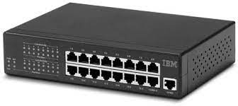
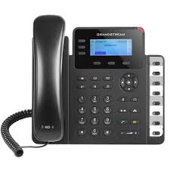



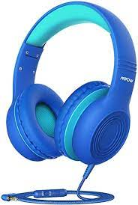
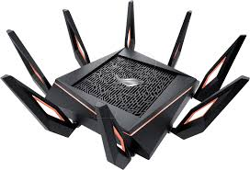
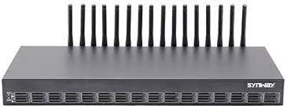

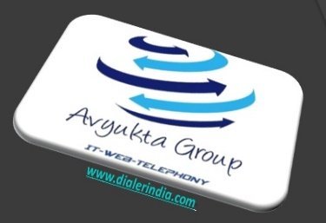
SBE Finance Case Study
SBE Finance Call Flow
Predefined and Custom
SMS
INB and OB Calls
Call Backs /Outbound from GSM
Agent Floor
Inbound Calls From New / Existing Customers
Customer records verification from database.
Switch
Avyukta
Dialer
Server
Wi-Fi Router
Sales Force
USB Headphone
IP Phone
Soft Phone
Agent PC
Admin Quality/Supervisor/TL
25+ Reports
Voice Logs
GSM Gateway
Optional Internet for
admins
Complete Recordings logs
Campaign Manager

Slide 9

SBE Finance Case Study
SBE Finance Architecture
GSM Gateway
Agent Floor
INB / OB Calls From TSP GSM Network
Avyukta
Dialer
Server
Switch
Wi-Fi Router
Sales Force
USB Headphone
IP Phone
Soft Phone
Agent PC
Admin Quality/Supervisor/TL
25+ Reports
Voice Logs
Optional Internet for
admins
Complete Recordings logs
Campaign Manager

Slide 10



E com / Mobile Apps / Website
Political Elections / Campaigns
24 X 7 X 365 “Decade” of 1900+ Satisfied BPO’s
avyuktaindia
The Competition Assassinators
275+ Live Ref. Centres
11 Yrs. X Asterisks Dev.
9 Countries,91+ Cities
Live Demo / PoC
Lower than the Lowest Professional Bidder
All possible Techno-commercial models
No Blame Game : Your CTI-CRM-VoIP “SPOC”
100% Gov. Compliance
72 HR Refund Policy
10% Ref. discount/s
24X6 Support NoC
“The” single Answer to your
A to Z
Tel- ”e” - calling requirements
Restaurant / Hotels / Customer Care
OBD / Press 1/ Voice SMS / Masking / OTP / 1800
Insurance / Shares / Loan / DSA’s
Predictive / Auto Dialer: Current Calls/ Output X 400%
Smart IVR / Cloud Telephony / Omni Channel / CRM / API
Survey / Appointment Setting / Lead Generation
Recruitment / MIS / Placements / Admissions
Taxi Services / BPO / Collections
Hosted / Premised / BPO / DoT VoIP / PRI / GSM Gateway
Domestic International Call Center / BPO Setup
Astrology / Universities / Colleges
Survey / Appointment Setting / Lead generation
+1-408-791-3820
+91-856-00-00-600
sales@dialerindia.com
Avyukta Intellicall www.dialerindia.com

Slide 11
















Trust over 11+ years
Some* Major Clients

Slide 12
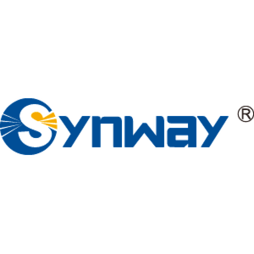

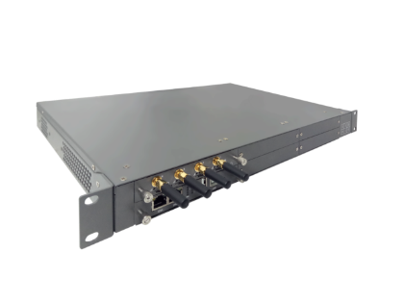



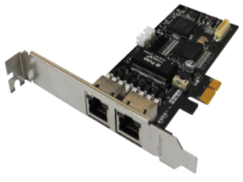



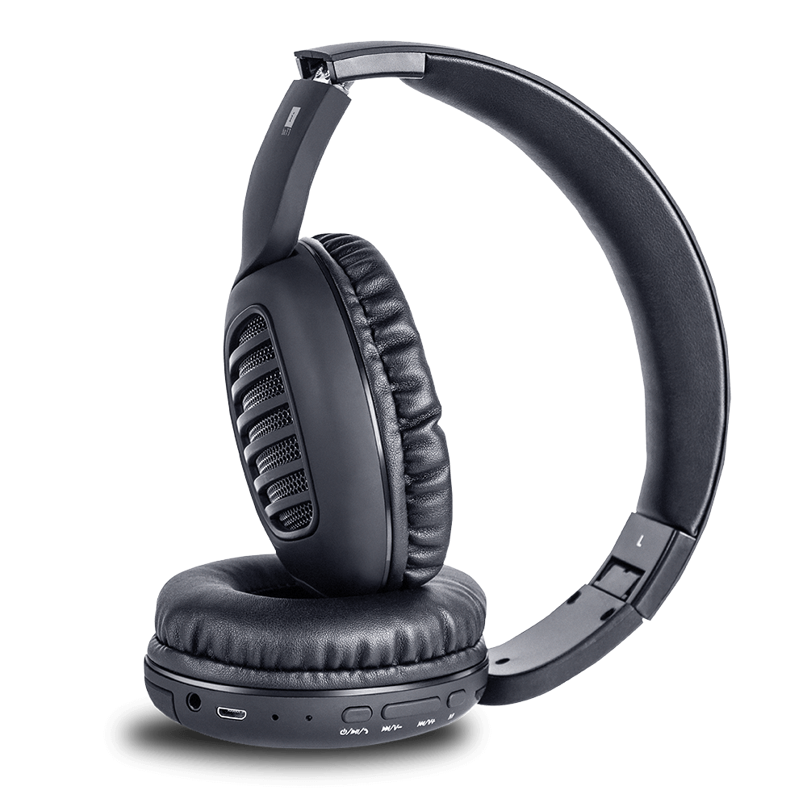



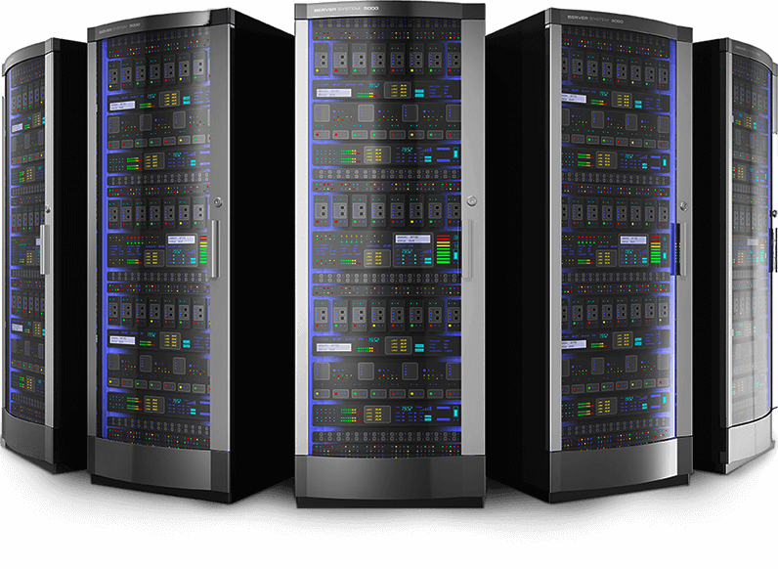
CTI Hardware Partners

Slide 13
Useful links
Domestic Architectures
International Architectures
Demo Video
Video Tutorials
Sample Voice Overs, Jingles and Melodies
DoT License / OSP Registration
PRI card / GSM Gateway / IP Phones / Headphone Buy Online
Vendor Comparison
Avyukta CRM Demo Video
Avyukta Sales CRM Demo Video
Avyukta Task CRM Demo Video
Avyukta Today CRM Demo Video
Request a Demo
Avyukta Client CRM Login
Support SLA
Avyukta on Youtube
Avyukta on Linkedin

Slide 14
SBE Finance Case Study
Thank You for Your Time

